Slide 1
Ondernemen
Nacholing leraren M&O/bedrijfseconomie
Prof. Enno Masurel

Slide 2
Agenda
Introductie
Achtergronden van ondernemerschap
Causation/Effectuation
SWOT-analyse
Vijfkrachtenmodel van Porter
Business Model Canvas 2017*
Maatschappelijk verantwoord ondernemen

Slide 3
Introductie

Slide 4
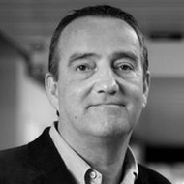
Enno Masurel
Full Professor Sustainable Entrepreneurship
Vrije Universiteit Amsterdam
‘Mr. Brightside’
Education
Research
Management
Valorization
Capacity building in Africa
Consultancies and presentations
Recent publications
Bossink, B., en E. Masurel (2017) Maatschappelijk verantwoord ondernemen, 2e druk,
Eyana, S.M., E. Masurel, and L. J. Paas (2017) Causation and effectuation behavior of Ethiopian entrepreneurs: Implications on performance of small tourism firms, Journal of Small Business and Enterprise Development (accepted for publication).
Masurel, E., and J. Rens (2015) How is CSR-intensity related to the entrepreneur’s motivation to engage in in CSR? Empirical evidence from small and medium-sized enterprises in the Dutch construction sector, International Review of Entrepreneurship, 13(4), 333-348.
Mol, M.C., and E. Masurel (2014) Innovation protection in the Dutch printing industry, International Journal of Intellectual Property Management, 7 (1-2), 84-99.

Slide 5
Wie bent u?

Slide 6
Achtergronden van ondenemerschap

Slide 7
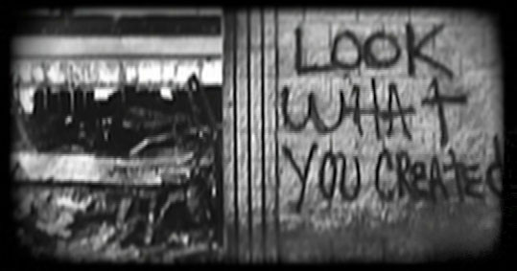
Entrepreneurship is the creation, discovery and exploitation of value-adding opportunities

Slide 8
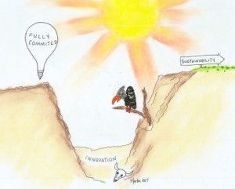
The valley of entrepreneurial death

Slide 9
Entrepreneurship is the creation, discovery and exploitation of value-adding opportunities

Slide 10
Learning for entrepreneurship
Learning about entrepreneurship

Slide 11
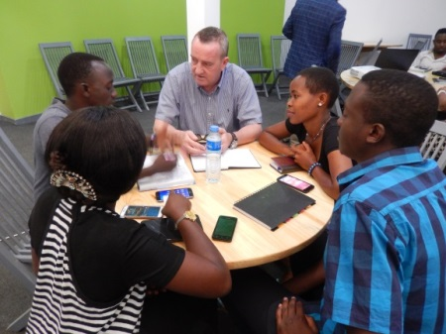
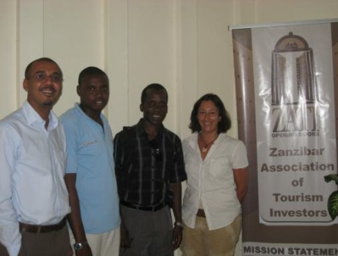
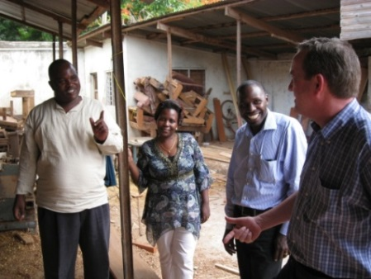
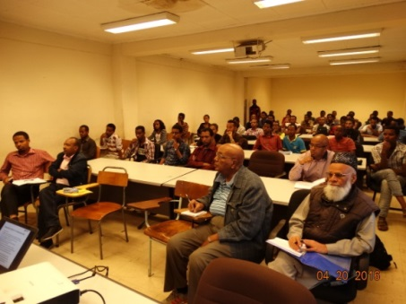
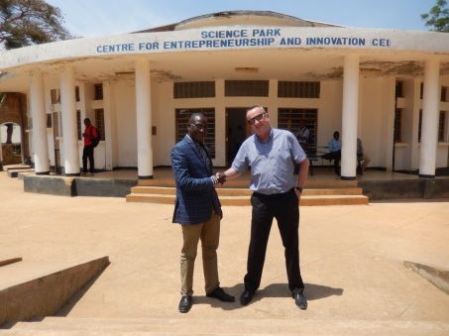
Entrepreneurship is everywhere, not only in the western world

Slide 12
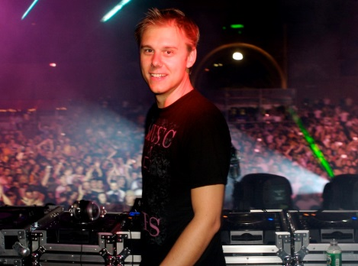
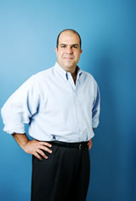
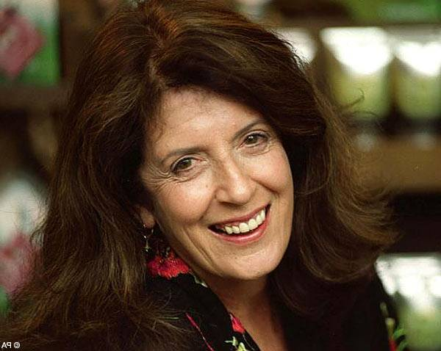
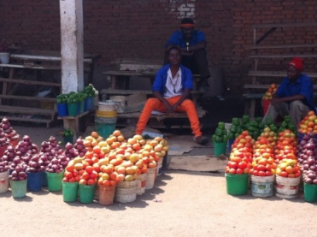
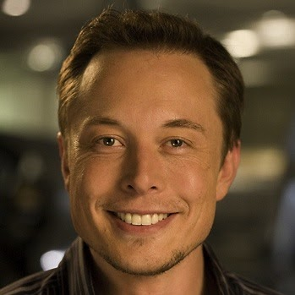
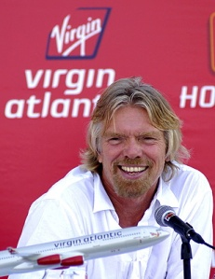
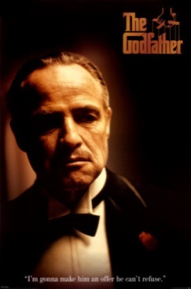
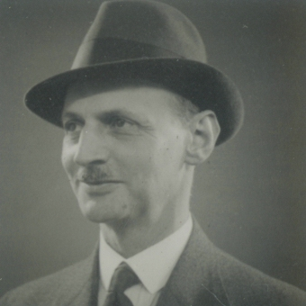
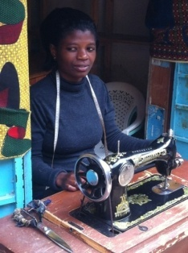
Many types of entrepreneurs
New entrepreneurs
Nascent entrepreneurs
Serial entrepreneurs
Portfolio entrepreneurs
Gazelle entrepreneurs
Stable entrepreneurs
Sustainable entrepreneurs
Social entrepreneurs
Corporate entrepreneurs
Publicpreneurs
Governpreneurs
Academic entrepreneurs
Former entrepreneurs
Lifestyle entrepreneurs
Studentrepreneurs©
Criminal entrepreneurs
And more…

Slide 13
Many types of entrepreneurs
New entrepreneurs
Nascent entrepreneurs
Serial entrepreneurs
Portfolio entrepreneurs
Gazelle entrepreneurs
Stable entrepreneurs
Sustainable entrepreneurs
Social entrepreneurs
Corporate entrepreneurs
Publicpreneurs
Governpreneurs
Academic entrepreneurs
Former entrepreneurs
Lifestyle entrepreneurs
Studentrepreneurs©
Criminal entrepreneurs
And more…

Slide 14
Causation/Effectuation

Slide 15
Causation/Effectuation
Causation: entrepreneurs determine their goals and look for the resources to realize these goals.
Effectuation: entrepreneurs look at their resources and determine goals according to the resources they posses.
Causation is more about planning and effectuation is more about opportunism.
Five principles of effectuation:
1. Bird-in-hand (start with your means) versus pre-set goals.
2. Affordable loss (focus on downside risks) versus expected returns.
3. Lemonade (leverage contingencies) versus avoiding surprises.
4. Patchwork quilt (form partnerships) versus competitive analysis.
5. Pilot-in-the-plane (control) versus inevitable trends.

Slide 16
Maar wat kun je met deze kennis doen?
Gedrag van ondernemers analyseren
Prestaties van ondernemers verklaren
…..

Slide 17
SWOT-analyse

Slide 18
SWOT-analyse
SW / sterkten & zwaktes: het gaat om interne zaken in het heden. Nadat de sterktes van de onderneming zijn vastgesteld moet de vraag beantwoord worden of deze wel voldoende worden benut. Nadat de zwaktes van de onderneming zijn vastgesteld moet de vraag beantwoord worden hoe deze worden geneutraliseerd.
OT / kansen & bedreigingen: het gaat om externe ontwikkelingen in de toekomst. Nadat de kansen en bedreigingen voor de onderneming zijn vastgesteld moet de vraag worden beantwoord welke veranderingen in de onderneming moeten worden doorgevoerd om daarop in te spelen. Overigens kan een externe ontwikkeling zowel een kans als een bedreiging zijn. Niet al te ver vooruit denken.

Slide 19
Voorbeeld van een SWOT-analyse
Sterktes
Financieel draagvlak
Betrokkenheid medewerkers
Zwaktes
Interne organisatie
Regionale profilering
Bedreigingen
Ketenintegratie
Krappe arbeidsmarkt
Kansen
Verduurzaming samenleving
Technologische ontwikkeling

Slide 20
Vijfkrachtenmodel van Porter

Slide 21
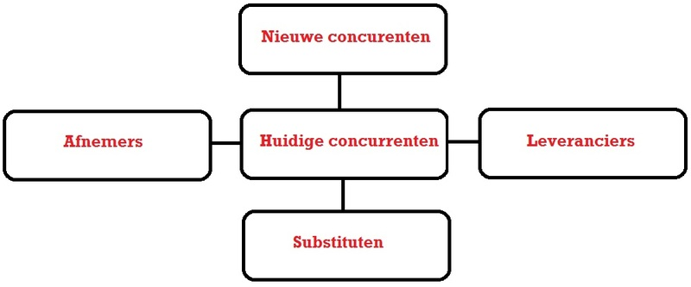

Slide 22
Het vijfkrachtenmodel van Porter helpt om de relatieve machtspositie van de onderneming te bepalen ten opzichte van afnemers, leveranciers, concurrenten, nieuwe toetreders en substituten (én overheid…). Denk daarbij aan uniciteit en aantallen maar ook aan bijvoorbeeld de gunfactor.

Slide 23
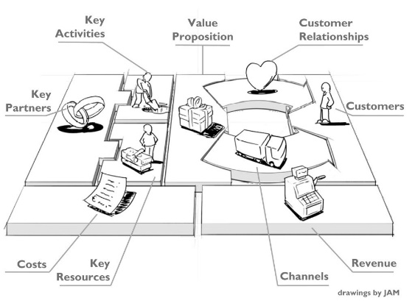
Business Model Canvas 2017*

Slide 25
Toegevoegd aan het traditionele BMC
Coach
Bescherming
Exit strategie
Resultatenrekening, balans en liquiditeitsplanning
Duurzaamheidsparagraaf

Slide 27
MVO is het leiden van een commerciële of niet-winstgedreven organisatie door het maken van vrijwillige, gebalanceerde keuzes tussen de economische aspecten, sociale aspecten en ecologische aspecten van de bedrijfsvoering

Slide 28
MVO is ook: dé Manier Van Ondernemen

Slide 29
MVO-beleid op stakeholders afstemmen
Klanten
Leveranciers
Werknemers
Concurrenten
Aandeelhouders
Banken
Brancheorganisaties
Vakbonden
Belangengroeperingen
Consumentenorganisaties
Overheden
Omwonenden
Media
Mensenrechtenorganisaties
…..

Slide 30
You are CEO of Company X What do you prefer?
#1: top in profit (high returns for shareholders; poor relationship with employees; unpopular in local community due to pollution)
#2: top in people (winner of several ‘Best Employer’ awards; poor financial performance; ‘green neutral’)
#3: top in planet (‘dark green’; high cost level; job cuts)

Slide 31
Macht, legitimiteit en urgentie van stakeholders

Slide 32
Instrumenten voor MVO-integratie
MVO Balanced scorecard
INK-model
Waardeketen-analyse

Slide 33
Balanced Scorecard
Kaplan & Norton (1992)
Semi-structured overview for tracking the strategic development of the firm
Four fields: Financial; Customers/market; Internal processes; Learning and development
To be interpreted as descriptive of prescriptive
Relate to period or as external benchmark
‘Free’ choice of ratios
No/not necessary significant relationship between the ratios and the strategic development of the firm

Slide 34
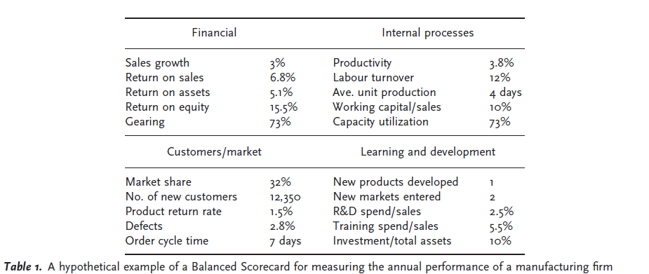

Slide 35
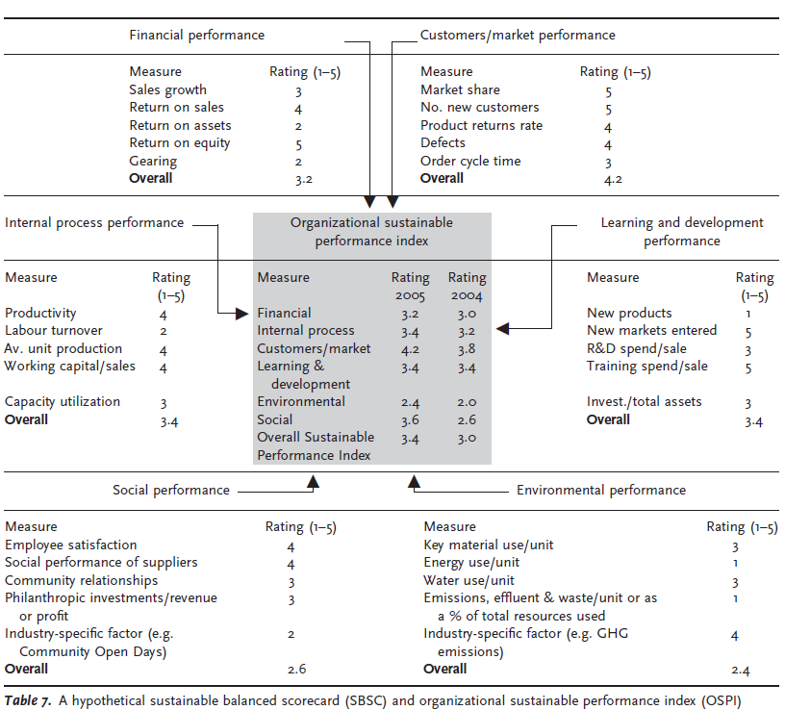
3.2

Slide 36
Sustainable Balanced Scorecard
 | Economic Value | Social Value | Ecological Value | Total Value
Benefits
Costs
Balance

Slide 37
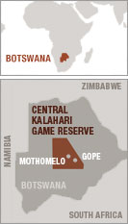
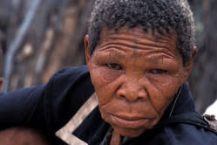
A dilemma…
You are the owner-manager of a medium-sized tour operating firm from the EU. Your firm employs about 30 people. You are invited to do business with Wilderness Safaris in the Kalahari Desert in Botswana. This is a very lucrative offer, but there is an issue about the human rights of the local bushmen.
However, you are not allowed to interfere with this issue, neither directly nor indirectly, under penalty of a giant insurance claim.
On the other hand, your firm is in serious problems, as a result of fierce competition. There is a serious threat of bankruptcy, which will have far-reaching consequences for your family income. If you do not sign this contract, you most probably have to sack a number of your employees.
Are you accepting the offer from Botswana or not?
How do you make your decision?

Slide 38
Outrage as Botswana Bushmen denied access to water
http://www.survivalinternational.org/films/bushmenjohnsimpson

Slide 39
Sustainable Balanced Scorecard
 | Economic Value | Social Value | Ecological Value | Total Value
Benefits
Costs
Balance
You are the owner-manager of a medium-sized tour operating firm from the EU. Your firm employs about 30 people. You are invited to do business with Wilderness Safaris in the Kalahari Desert in Botswana. This is a very lucrative offer, but there is an issue about the human rights of the local bushmen. However, you are not allowed to interfere with this issue, neither directly nor indirectly under penalty of a giant insurance claim. On the other hand, your firm is in serious problems, as a result of fierce competition. There is a serious threat of bankruptcy, which will have far-reaching consequences for your family income. If you do not sign this contract, you most probably have to sack a number of your employees. Are you accepting the offer from Botswana or not? How do you make your decision? Discuss this issue with your neighbor and use the Sustainability Balanced Scorecard.

Slide 40
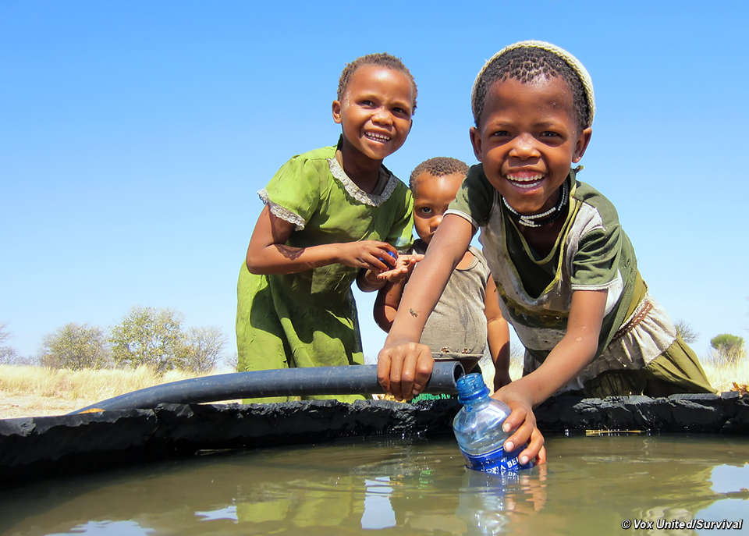
Bushman girls enjoy water from the well at Mothomelo Borehole breakthrough for Botswana’s Bushmen Survival International has been speaking to Bushmen from the Central Kalahari Game Reserve as they celebrate drinking water from the Mothomelo borehole for the first time in nine years. It marks a significant step towards their full return to their ancestral lands following a landmark court ruling in 2006. Despite winning Botswana’s longest running court case over four years ago, the Busmen’s fundamental right to water was only recognized this January by Botswana’s appeal court.

Slide 41
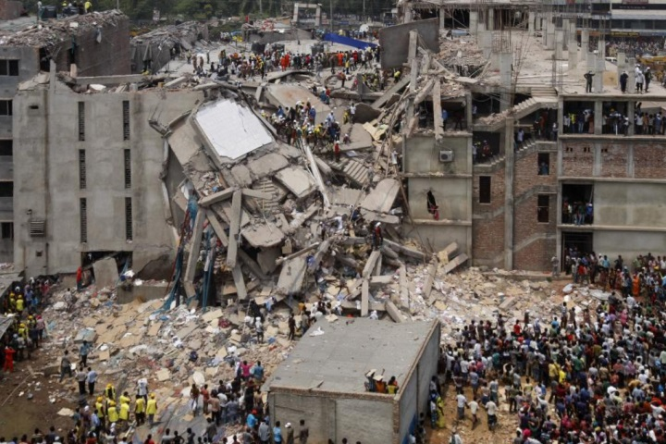
Leuke opdracht voor uw leerlingen: Over de rol van hen zelf in de relatie tussen Nederlandse modewinkels en leveranciers uit ontwikkelingslanden

Slide 42
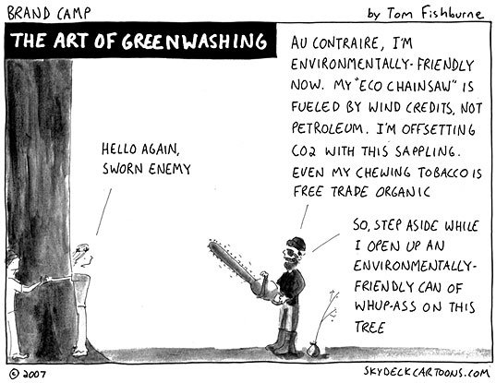
Beware of green washing practices! (the unfair practice of firms to present their products and policies as environmentally friendly / sustainable while they are not; a.k.a. window dressing)

Slide 43
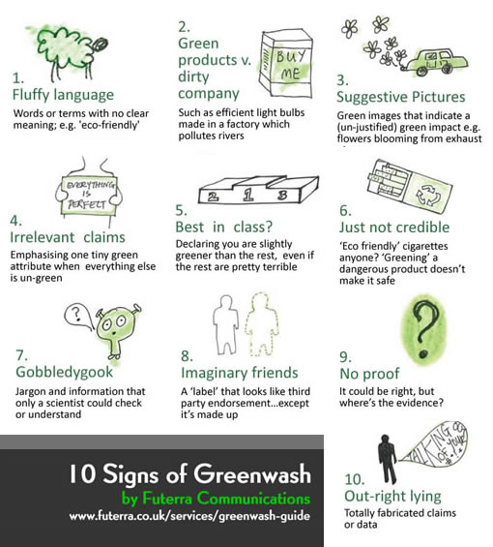

Slide 44
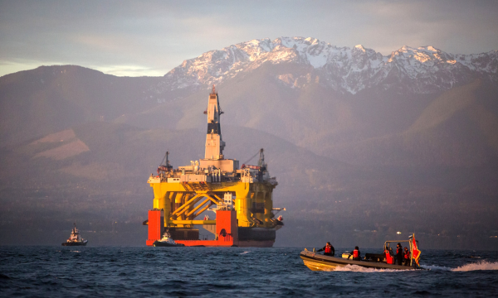
Shell abandons Alaska Arctic drilling
Oil giant’s US president says hugely controversial drilling operations off Alaska will stop for ‘foreseeable future’ as drilling finds little oil and gas. The Transocean Polar Pioneer, a semi-submersible drilling unit leased by Shell, was used to explore Arctic deposits. Shell has abandoned its controversial drilling operations in the Alaskan Arctic in the face of mounting opposition in what jubilant environmentalists described as “an unmitigated defeat” for big oil. The Anglo-Dutch company had repeatedly stressed the enormous hydrocarbon potential of the far north region in public, but in private began to admit it had been surprised by the popular opposition it faced. Shell said today it had made a marginal discovery of oil and gas with its summer exploration in the Chukchi Sea but not enough to continue to the search for the “foreseeable” future.
Source: www.theguardian.com
Our approach:
“We are committed to protect the environment, respect our neighbours, cause no harm to people, and help the world move towards a lower-carbon future”
Source: www.shell.com/sustainability/environment.html

Slide 45
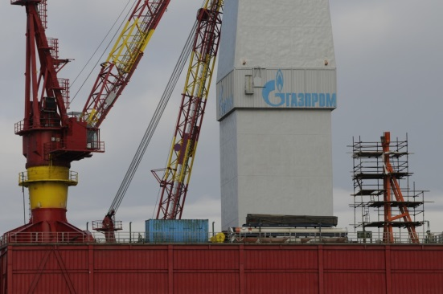
Shell abandons Alaska Arctic drilling
Oil giant’s US president says hugely controversial drilling operations off Alaska will stop for ‘foreseeable future’ as drilling finds little oil and gas. The Transocean Polar Pioneer, a semi-submersible drilling unit leased by Shell, was used to explore Arctic deposits. Shell has abandoned its controversial drilling operations in the Alaskan Arctic in the face of mounting opposition in what jubilant environmentalists described as “an unmitigated defeat” for big oil. The Anglo-Dutch company had repeatedly stressed the enormous hydrocarbon potential of the far north region in public, but in private began to admit it had been surprised by the popular opposition it faced. Shell said today it had made a marginal discovery of oil and gas with its summer exploration in the Chukchi Sea but not enough to continue to the search for the “foreseeable” future.
Source: www.theguardian.com
Gazprom to resume Kara Sea drilling
Announces tender for rig, supply and service vessels for drilling the Leningradskaya gas field.
Our approach:
“We are committed to protect the environment, respect our neighbours, cause no harm to people, and help the world move towards a lower-carbon future”
Source: www.shell.com/sustainability/environment.html

Slide 46
Nog een leuke opdracht voor uw leerlingen: Over de rol van hen zelf, hun smartphones en producenten in ontwikkelingslanden

Slide 47
Samengevat
Introductie
Achtergronden van ondernemerschap
Causation/Effectuation
SWOT-analyse
Vijfkrachtenmodel van Porter
Business Model Canvas 2017*
Maatschappelijk verantwoord ondernemen

Slide 48
Veel succes gewenst!
Vragen?
U kunt me altijd mailen: e.masurel@vu.nl

